Slide 1
Distribution Transformer MAINTENANCE USING Iot and Ml

Slide 2
Introduction
Transformer Failures
Power cut-off is one of the major problem.
The user is unaware of the problem.
Technicians are notified by the locals.
power transmission experience significant loss
distribution companies experience significant loss

Slide 3
PROBLEM STATEMENT
Late problem detection
Irregular maintenance
inefficient working
reduced life span
Major delays
Zero monitoring
repair time
cost shoots up.
Decreases efficency
People face big issue during power-cut
They are in the dark about the status of electricity
No chores are possible
confusion due to ineffective communication

Slide 4
PROBLEM SOLUTION
Early problem detection
Regular maintenance
More efficiency
Prolonged life span
Cancels Delays
RealTime monitoring
Reduction in Cost
NO MAJOR FALIUR
Warning of power cuts.
The transformer status will be known.
Will help manage routine/classes.
Effective communication

Slide 5
REASONS OF DETERIORATION

Slide 6
HARDWARE COMPONENTS
Arduino Nano
Current Sensor
(ACS712 CurrentSensor)
Oil temperature sensor (DS18B20 Waterproof Temperature Sensor Probe)
Power
supply
Oil level sensor (Float level sensor)
Winding temperature sensor (LM35 Temperature sensor)
ArGas sensor (MQ135) 13. GSM (SIM800L)
GSM
Humidity sensor (DHT22/AM2302 Digital Temperature Humi&dity Sensor)

Slide 7
SENSOR DETAILS
Voltage and Current sensor: Measure the voltage and current output in the PCMN module.
Winding temperature sensor: Measure the temperature in the transformer windings. The rise in voltage temperature increases the voltage of the windings which is not good for the health of the transforme

Slide 8
SENSOR DETAILS
Oil Temperature sensor: The transformer is filled with oil. It measures the temperature of the transformer oil. Float level sensor: The level of oil in the transformer is measured with this. Very low oil levels in the transformer will result in overheating of the windings and the very high oil level can cause over-pressurization when oil expands.
Humidity Sensor: The humidity sensor is mounted outside of the transformer to measure the humidity in the environment.

Slide 9
SENSOR DETAILS
Gas Detection Sensor: This sensor will measure the gas present in the oil tank. GSM module: The collected data from all the sensors is transmitted using the GSM module. The data is transmitted periodically or if there is a significant change in the parameters of the transformer.
A float switch: this is a device used to detect the level of liquid within a tank. This switch will be used in the auxiliary tank to detect the oil level and calculate the main tank oil level. It will also help us to know if there is oil leakage.

Slide 10
Implementation Details
In Transformer Monitoring System:
Data is collected by above mentioned sensors.
Use of GSM module for wireless transmission of data.
The data collected is sent to analysis.
Data will be uploaded on the server.
Data analysis using machine learning algorithm.
Real time panel for Electricity Department.
supervised learning for better accuracy of the model.
could label the problems while repairing (aid supervised learning)

Slide 11
Software details
For IoT and Sensors :
Arduino IDE
Thing speaks IoT analytics Platform
For the Web Application
Php– For building the framework of the website
SQL for storing the data in the backend.
CSS, HTML and Javascript for Frontend Development of the web application.
For Data Analysis
Python – To train the ML models.
Libraries : Sci lab and Pandas

Slide 12
Web-based GUI
Transformer status and predictions
Transformer detection/locality
Panel to lodge complain to SEB(State Electricity Board) office
Both users and SEB staff friendly.
Locality status for users.

Slide 13
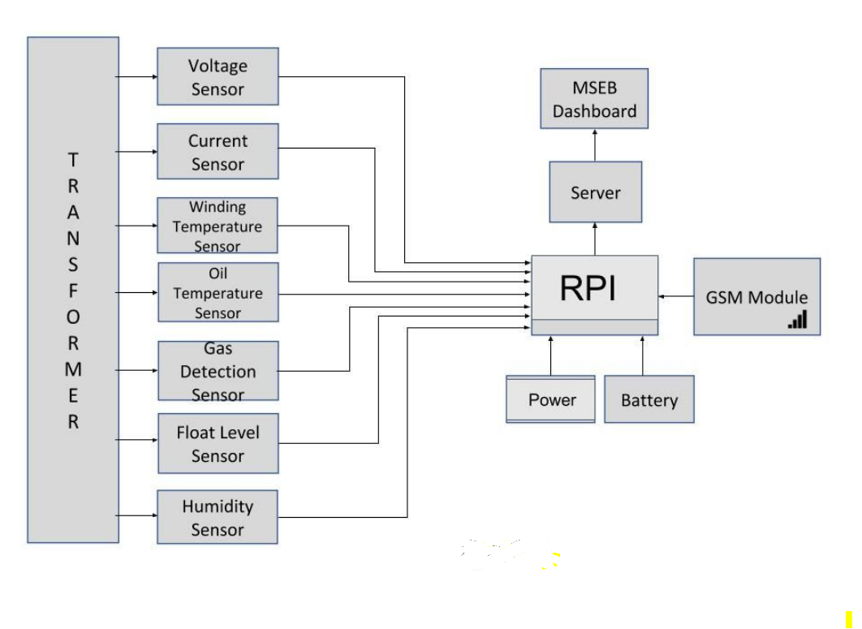
BLOCK DIAGRAM
Goa Electricity Department
Arduino Nano

Slide 14
OTHER COMPONENTS PRESENT
Circuit Breaker: The circuit breaker is used to trip the DAFP module in case of faults such as a short circuit.
Voltage Stabilizer: A voltage stabilizer is used for stabilizing the voltage in the range of “180v-270v” to 230v.
SMPS(Switch Mode Power Supply)/AC to DC Converter: Switch Mode Power supply/AC to DC Converter is used to convert 230v AC to 5 volts.
UPS/Battery: In a power failure, the breaker trips the circuit due to Undervoltage/overvoltage, the UPS(Uninterrupted Power Supply)/Battery is used to supply power to the microcontroller. Single-board microcontroller
Arduino nano: All the sensors and the GSM module will be connected to it with which we would be monitoring all the data parameters.

Slide 15
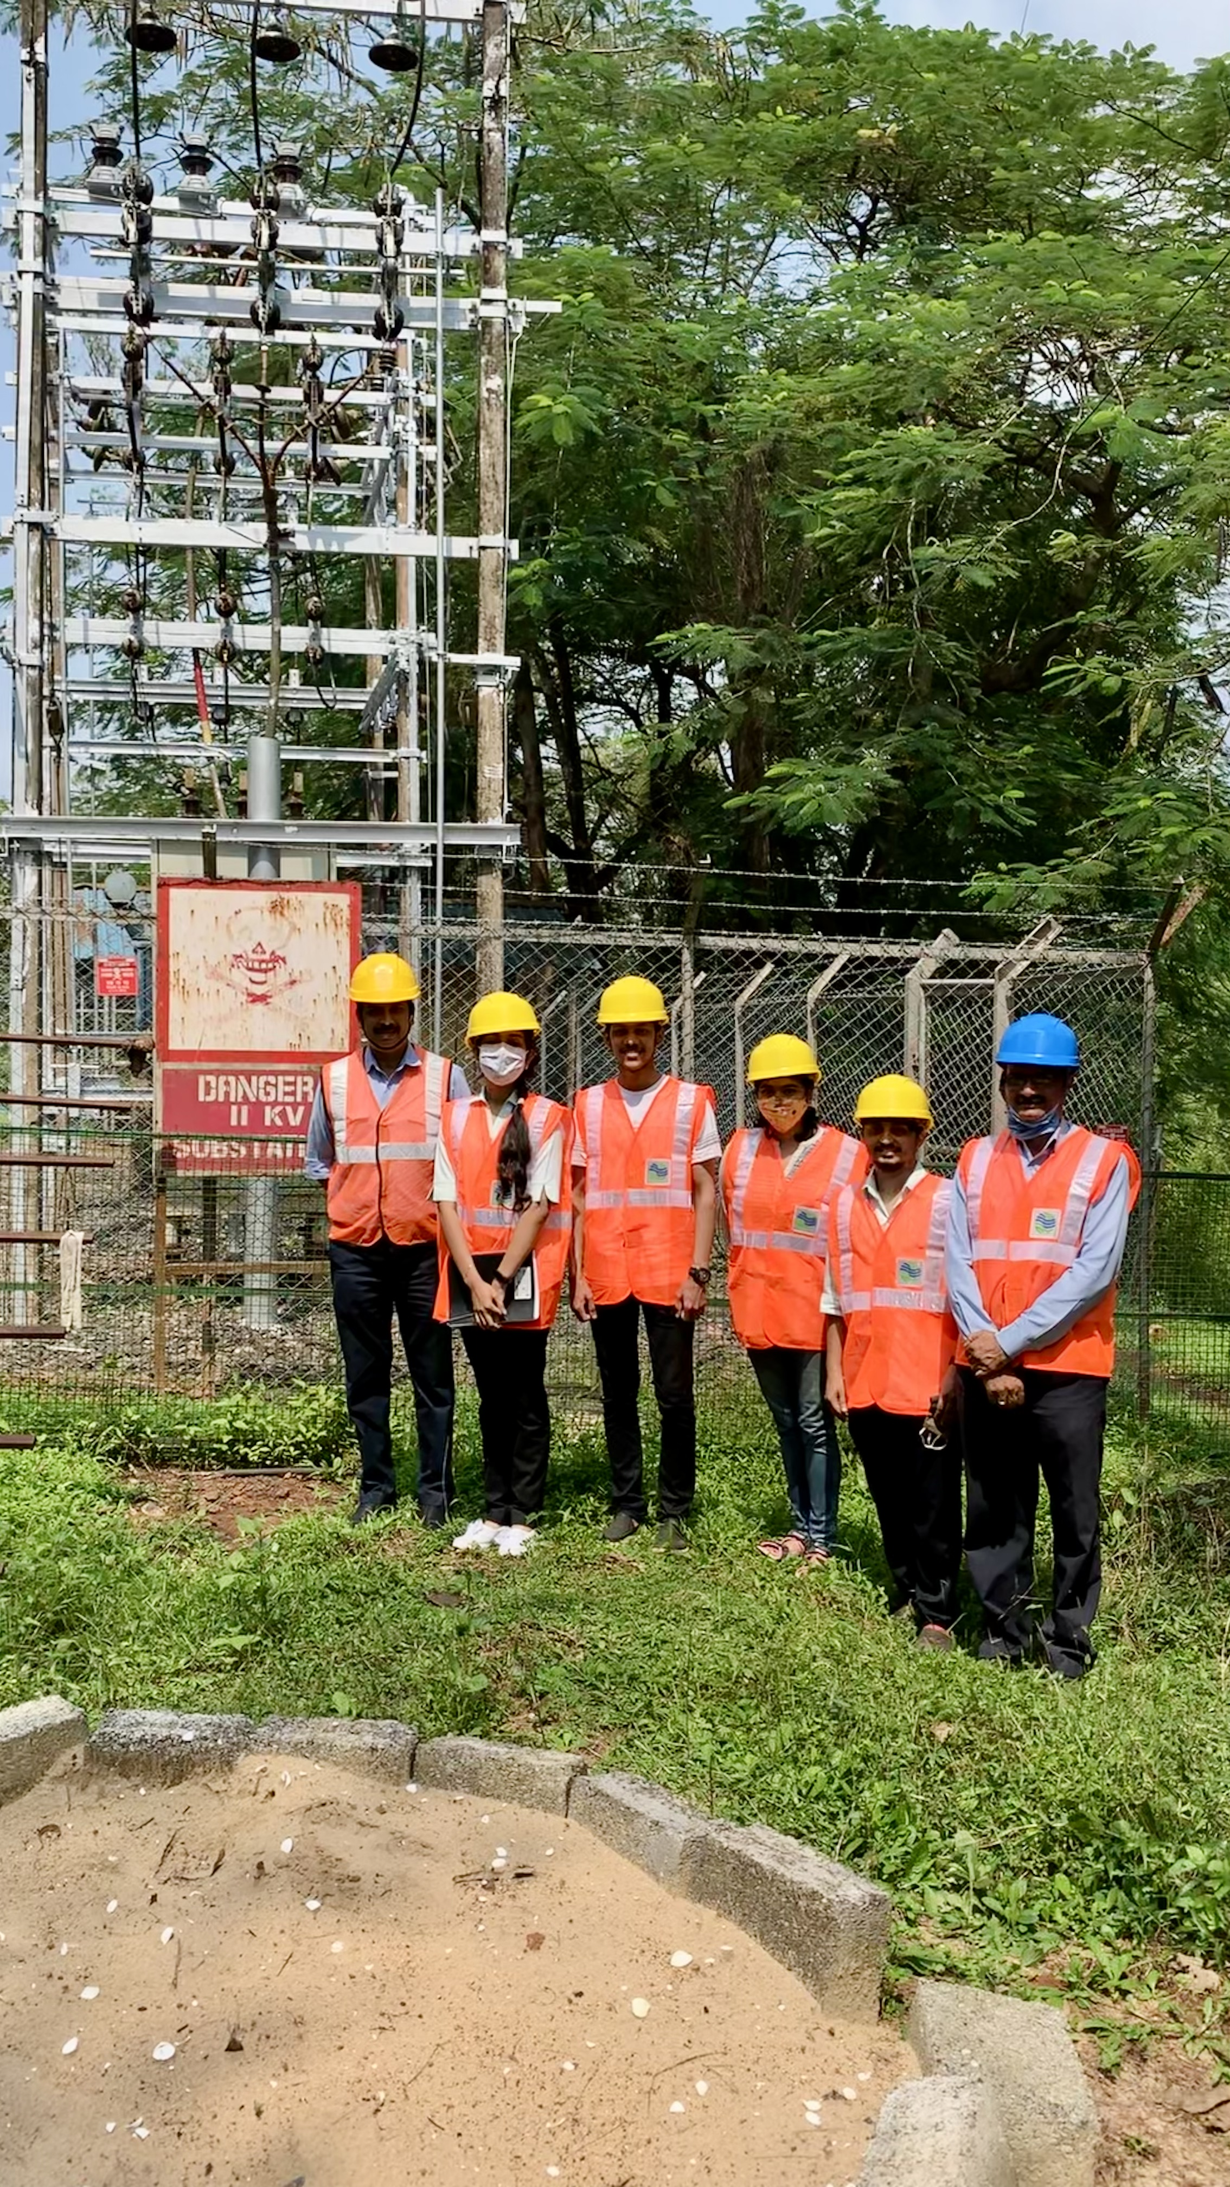

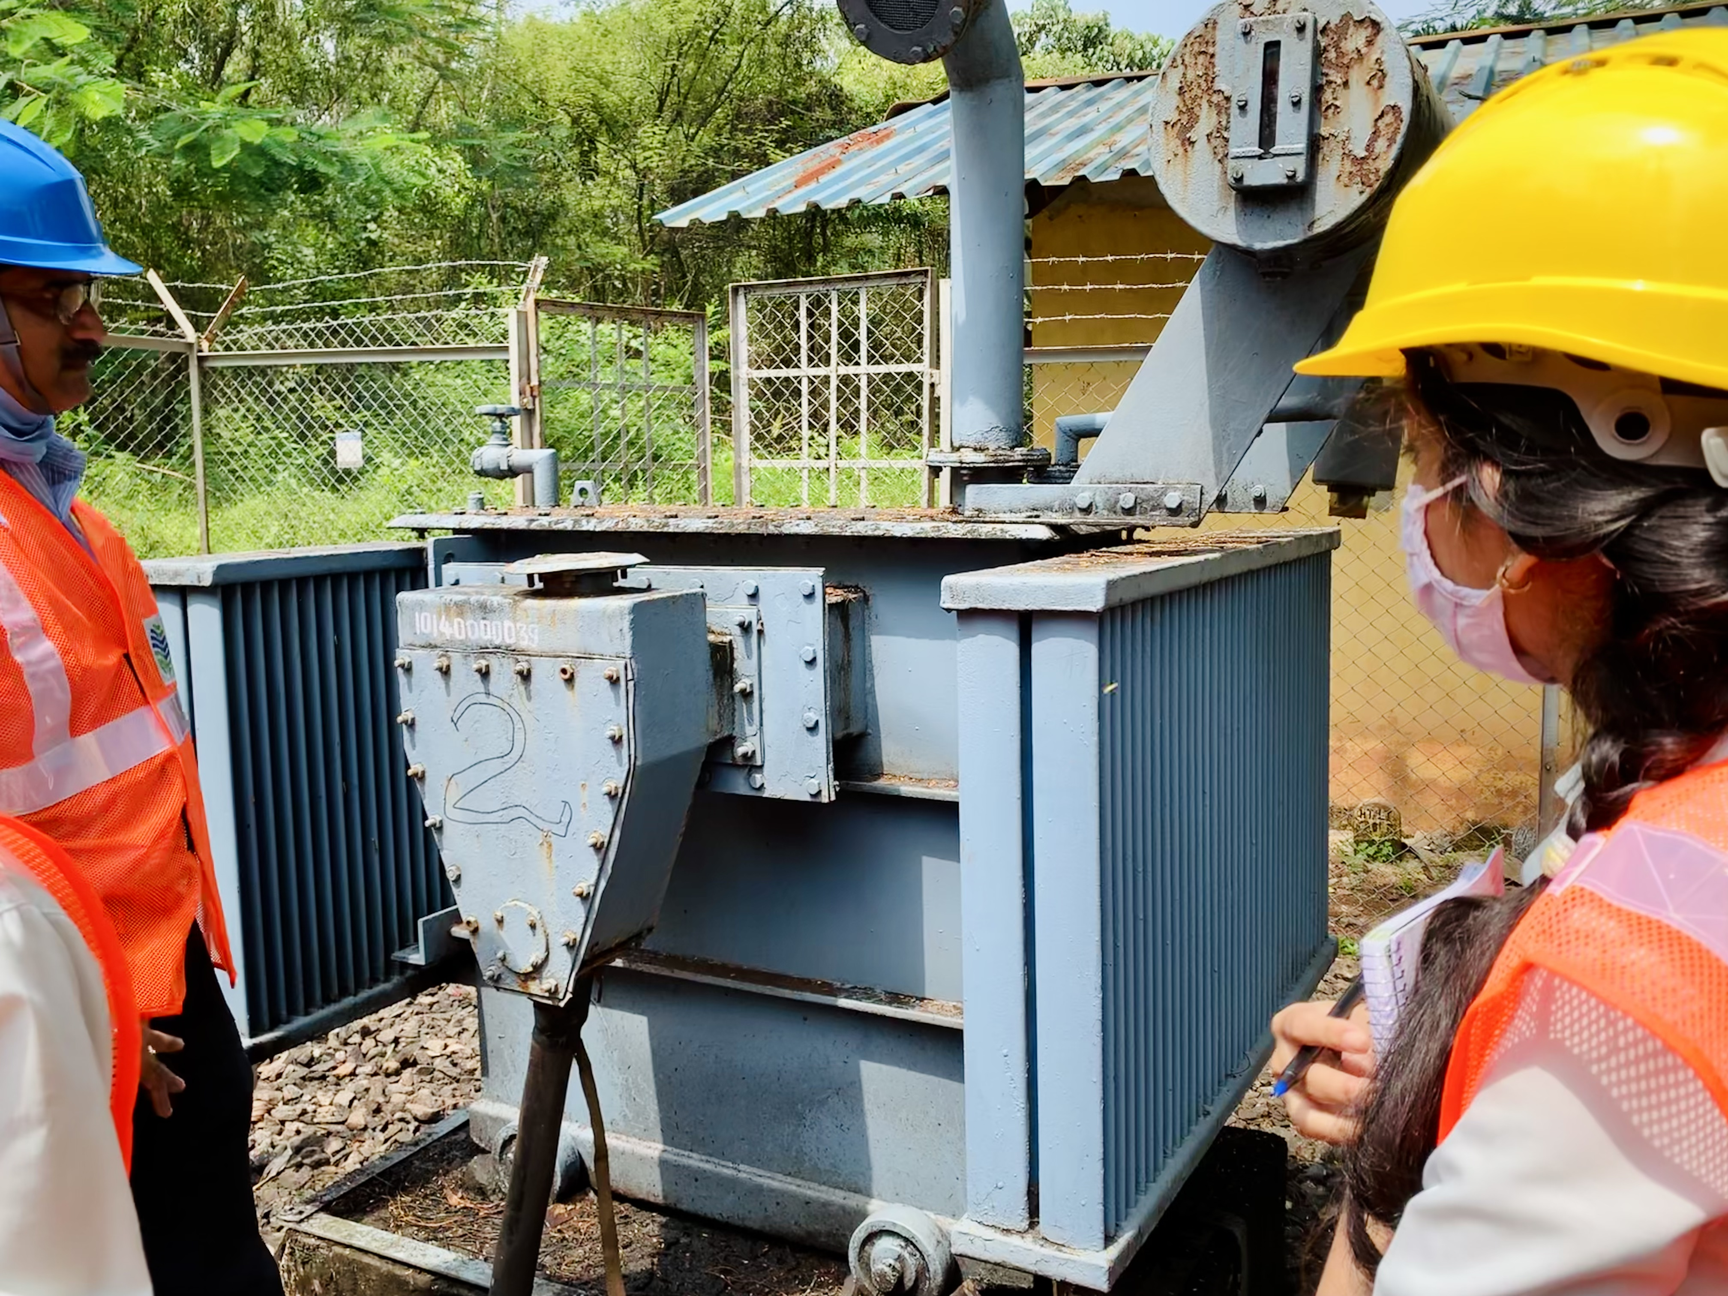
SITE VISIT TO SESA GOA

Slide 16
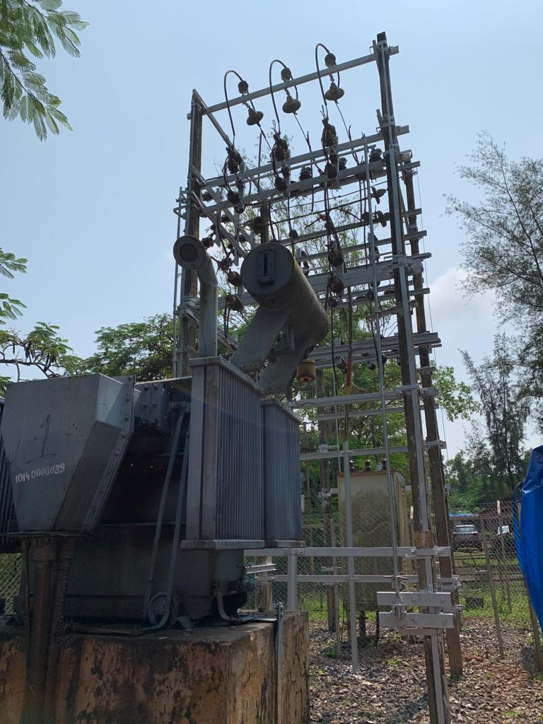
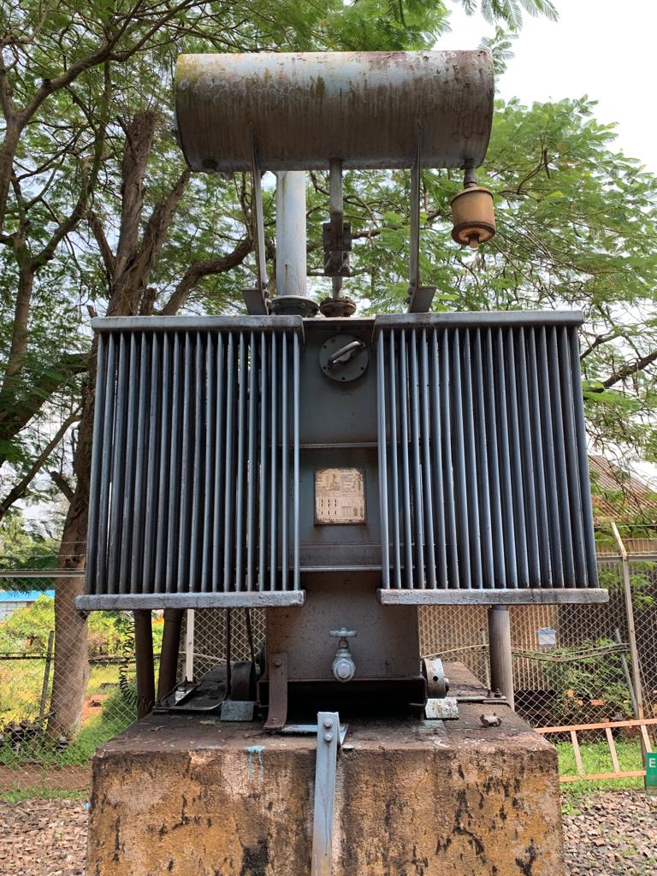
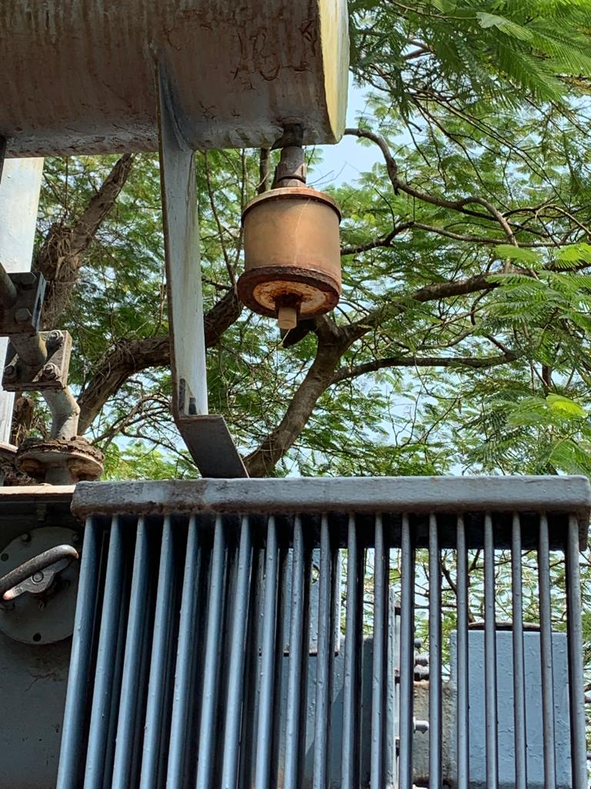
SITE VISIT TO SESA GOA

